Slide 1
Linear Regression
Presenters: Vijaya Cherukuri, Samantha Deokinanan, Habib Khan, & Priya Shaji
MSDS DATA 624
October 27th, 2020

Slide 2
Outline
Definition of Ordinary Least Square & What is a Best Fit? Simple Linear Regression Multivariate Regression Model | Priya Shaji
Pre-processing the Predictors Principal Component Analysis Partial Least Squares Penalized Models | Samantha Deokinanan
Selecting the Best Regression Models R-squared, RMSE, AIC, etc | Habib Khan
Example/Implementation | Vijaya Cherukuri

Slide 3
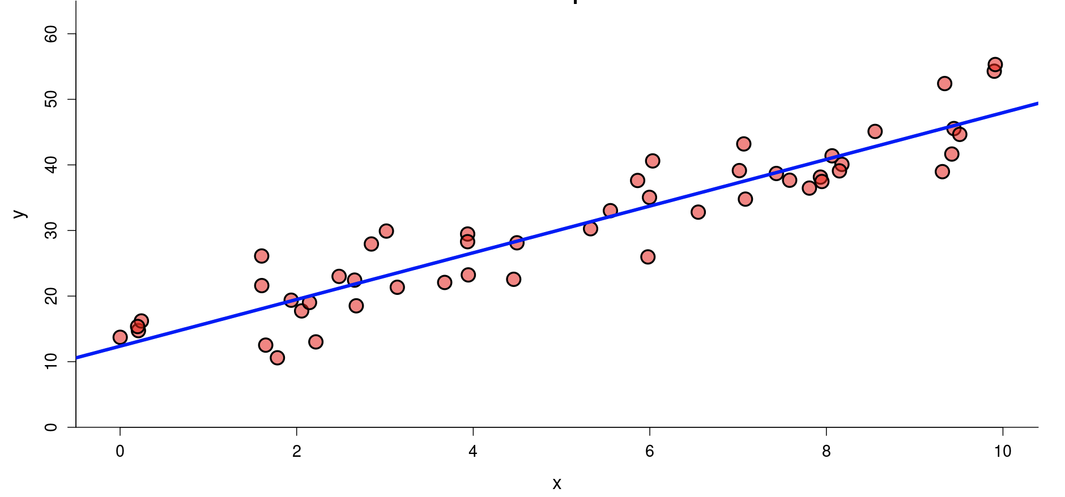
Definition
Priya
It’s a method to predict the target variable(Y) by fitting the best linear relationship between the dependent and independent variable(X).

Slide 4
Assumptions of Linear Regression
Priya
The Independent variables should be linearly related to the dependent variables.
Every feature in the data is Normally Distributed.
There should be little or no multicollinearity in the data.
The mean of the residual is zero.
Residuals obtained should be normally distributed.
Variance of the residual throughout the data should be same. This is known as homoscedasticity.
There should be little or no autocorrelation in the data.
Why do we need them? : The Gauss-Markov theorem states that if your linear regression model satisfies the first six classical assumptions, then ordinary least squares (OLS) regression produces unbiased estimates that have the smallest variance of all possible linear estimators.

Slide 5

Types of Linear Regression
Priya
Simple Linear Regression
In simple linear regression we find the relationship between a dependent Y and independent variable X.
β0, β1= model coefficients or parameters

Slide 6
Types of Linear Regression
Priya
Multivariate Linear regression
This method uses more than one independent variable(X1,X2,X3..) to predict a dependent variable(Y), by fitting a best linear relationship.
Y=mX1+mX2+mX3…+b
Properties of the Regression line:
1. The line minimizes the sum of squared difference between the observed values(actual y-value) and the predicted value(ŷ value)
2. The line passes through the mean of independent and dependent features.

Slide 7
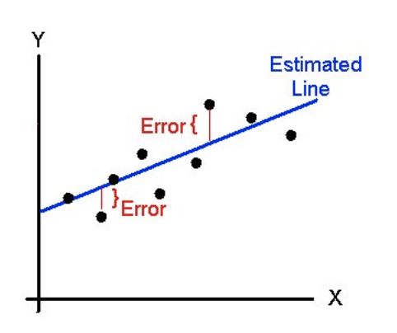
What is a best fit?
Priya
Least Squares Method: The best fit is done by making sure that the sum of all the distances between the shape and the actual observations at each point is as small as possible. The fit of the shape is “best” in the sense that no other position would produce less error given the choice of shape.

Slide 8
Pre-processing Predictors of Regression Model
Samantha
Multivariate regression approach will have high variability and will become unstable
Opt for multivariate regression analysis when:
high correlations among predictors
# of predictors > observations
X₁
X₂
Linear Composite
Response
X₃
X₄
Y = Xβ + ε

Slide 9
Principal Component Regression (PCR)
Samantha
Linear combinations of the predictive variables are extracting information from a higher dimensional data by projecting it to a lower dimension.
Standardized Linear Combination (SLC) of the data-matrix X is based on the EV decomposition of the Variance-Covariance or correlation matrix ∑ of X.
1st Principal Component (PC1):
λ with the largest absolute value will show that the data have the largest variance along its e
2nd Principal Component (PC2):
the direction with maximum variation left in data, orthogonal to 1st PC.
In general, only few directions manage to capture most of the variability in the data.
X₁
LC
X₂
LC
Linear Composite
Response
X₃
LC
X₄
LC
T = XW
Y = TP + ε
Y = Xβ + ε

Slide 10
Partial Least Squares (PLS)
Samantha
Unlike PCR, the PLS technique works by successively extracting factors from both predictive and target variables such that covariance between the extracted factors is maximized.
PLS technique tries to find a linear decomposition of X and Y such that
X = TP^{T} + ε_{X}
Y = UQ^{T} + ε_{Y}
Decomposition is finalized to maximize covariance between T and U, i.e. X-scores and Y-scores.
At the end of each iteration, X and Y are deflated by subtracting the current estimate of the predictor and response and are then used for the next iteration (i.e. X₁ = X – tt^{T}X and Y₁= Y – tt^{T}Y)
The process continues until all possible latent factors t and u is extracted, i.e when X is reduced to a null matrix.

Slide 11
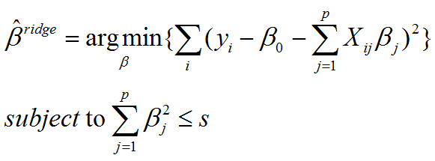
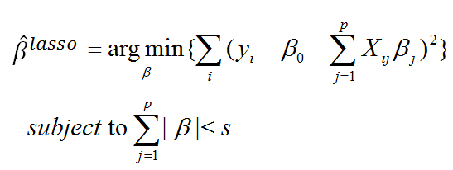
Penalized Models
Samantha
Shrinkage towards 0 tends to move estimated coefficients closer to the true coefficients.
imposing penalty on complexity of model to get lower variance.
Two example that added a penalty term for having large coefficients are:
Ridge regression by sum-of-squares of parameters.
LASSO (least absolute shrinkage and selection operator) by absolute value of parameter.
Elastic-Net Regression combines both ridge and lasso regression penalty, each having their own λs.
Best of both worlds plus it does a better job dealing with correlated parameters
s > 0, i.e. constraining the sum of the squared coefficients

Slide 12
Comparison
Samantha
Both PCR and PLS convert a group of correlated predictive variables to a group of predictors.
Both PCR and PLS construct a “strong” predictive variable from several “weaker” ones.
PCR does not consider the target variable. So, PCR is an unsupervised analysis.
PLS maximize the correlation between target and predictors. So, PLS is a supervised analysis.
PCR discards the smallest eigenvalue components (low-variance direction).
PLS shrink the low-variance direction, while inflate high variance direction.
Ridge Regression works best when most of the variables are useful; LASSO when most are useless (ie LASSO can perform parameter selection where Ridge cannot)
LASSO Regression can reduce slope to be exactly zero whereas Ridge Regression gets close to zero (due to the squaring term)

Slide 13
Selecting the Best Regression Model
Habib
Specify the maximum model.
Specify a criterion for selecting a model.
Specify a strategy for selecting variables.
Fit the model.
Evaluate the reliability of the model chosen.

Slide 14
1- Specify the Maximum Model
Habib
Largest possible model considered at any point throughout the model selection process without excluding any predictor.
Size of maximum model k large dependent on the sample size.
Requirement: Number of predictors cannot exceed number of observations.
Rule of Thumb: n should be greater than or equal to 5000.
Benefits: Ability to consider more complex predictors through interactions, controls, etc.
Reduces chances of making Type II error (A patient may be reported a negative result but in actual, infected).

Slide 15
2- Specifying Criterion
Habib
A metric that can be computed for each potential final model and compared against all others in contention to determine the best one.
F-stats
R-squared
Adjusted R-squared
RMSE
RSE
Mallow’s Cp
AIC
BIC

Slide 16
3- Specifying a strategy
Habib
Forward Selection
Insert the predictors that has highest correlation with the predictor.
Calculate the f-statistic for every variable and p-value each time with adding a predictor.
Repeat the steps until you get all significant predictors.
Backward Elimination
Removes a predictor one-by-one that has highest level of significance (p-value).
Repeat it until all the predictors are significant.

Slide 17
3- Specifying a Strategy (cont)
Habib
Stepwise Regression
It is a step-by-step iterative construction of a regression model that involves the selection of independent variables to be used in a final by adding or removing predictors in each iteration until get the best model.
An automated model selection with glmulti(): It is an automated model selection function in R which builds all possible unique model and selects the best model in terms of accuracy and performance.
It is time-consuming but practically brings the best model as compared with others.

Slide 18
4- Fit the Model
Habib
Model fitting is a measure of how well a model generalizes to similar data on which it was trained.
A well-fitted model will produce accurate predictions.
Check the regression diagnostics.
It is used to evaluate model assumptions which are linearity, homoscedasticity, independence and normality.
Check for overfit and underfit

Slide 19
5- Evaluate Reliability
Habib
Reliable Model
A model that predicts well for subsequent samples in the population that were not used in the original model fitting process.
A model that is overfit will fit the data well but will have a poor ability to predict new observations.
Typically, occurs when there are too many predictors but not enough sample size.
Split sample approach can help to evaluate reliability through splitting data into training and test.
Randomly assign each observation to either training or test set
Fit the regression model on training set. Obtain the regression coefficients and save predicted responses from training set.
Calculate R-square, adjusted R2, AIC, BIC and RMSE for both sets.
Calculate Shrinkage if required.

Slide 20
Implementing Linear Regression in R
Vijaya
Simple Linear Regression
Multiple Linear Regression
Penalized models : Lasso, Ridge, Elastic Net
Principal Component and Partial Least Squares Regression

Slide 21
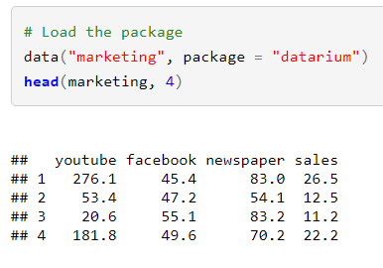
Simple & Multiple Linear Regression in R
Vijaya
Load packages and verify data :
We’ll use the marketing data set [datarium package]. It contains the impact of three advertising medias (youtube, facebook and newspaper) on sales. Data are the advertising budget in thousands of dollars along with the sales.

Slide 22
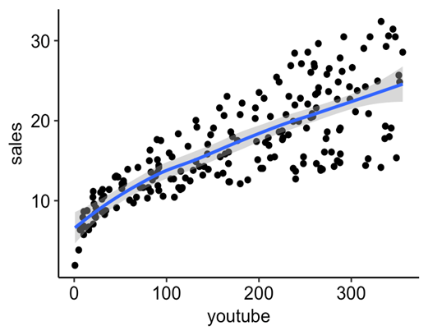
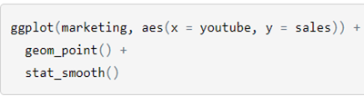
Simple Linear Regression
Vijaya
Visualization
Create a scatter plot displaying the sales units versus youtube advertising budget and add a smoothed line

Slide 23
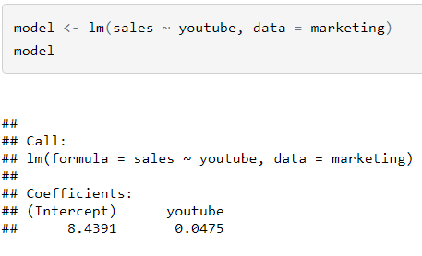
Computation
Vijaya
The simple linear regression tries to find the best line to predict sales on the basis of youtube advertising budget.
The linear model equation can be written as follow: sales = b0 + b1 * youtube
The R function lm() can be used to determine the beta coefficients of the linear model:

Slide 24
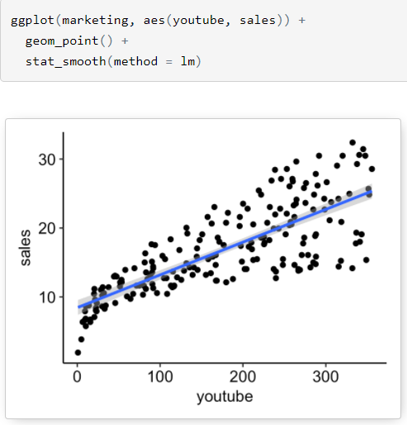
Regression Line
Vijaya
We used stat_smooth() function available under ggplot2 to add regression line for scatter plot.
By default, the fitted line is presented with confidence interval around it.

Slide 25
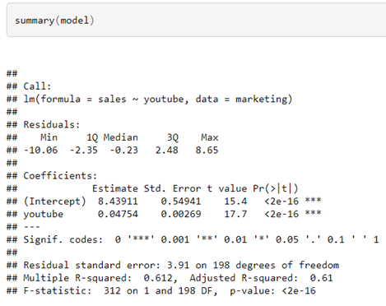

Model Summary & Accuracy
Vijaya
We start by displaying the statistical summary of the model using the R function summary():
The quality of the fit can be accessed by 3 values

Slide 26
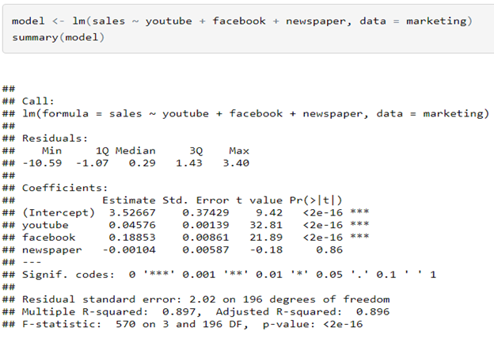
2. Multiple linear Regression - Building model
Vijaya
We want to build a model for estimating sales based on the advertising budget invested in youtube, facebook and newspaper, as follow:
sales = b0 + b1*youtube + b2*facebook + b3*newspaper

Slide 27
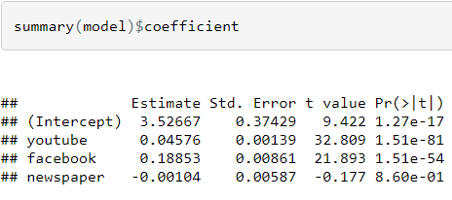
Interpretation
Vijaya
To see which predictor variables are significant, you can examine the coefficients table, which shows the estimate of regression beta coefficients and the associated t-statistic p-values:
It can be seen that, changing in youtube and facebook advertising budget are significantly associated to changes in sales while changes in newspaper budget is not significantly associated with sales.
Spending an additional 1 000 dollars on facebook advertising leads to an increase in sales by approximately 0.1885*1000 = 189 sale units, on average where as for YouTube it is 0.045*1000 = 45 sales units
Newspaper is not significant in the model means changing advertisements budget will not significantly affect sales.

Slide 28
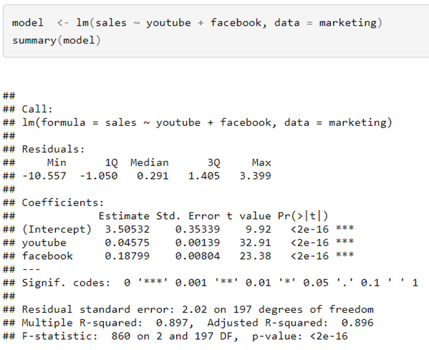
Final Model
Vijaya

Slide 29
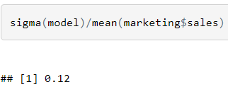
Model Accuracy & Summary
Vijaya
R Squared :
With the predictor variables, the adjusted R2 = 0.89, i.e. “89% of the variance in the measure of sales can be predicted by youtube and facebook advertising budgets. This model is better than the simple linear model with only youtube in simple-linear-regression, which had an adjusted R2 of 0.61.
Residual Standard Error (RSE) :
RSE is 2.023 corresponding to 12% error rate.
Again, better than the simple model, with only youtube variable, where the RSE was 3.9 (~23% error rate) in simple-linear-regression.

Slide 30
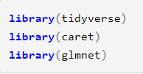
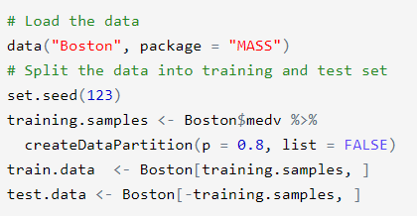
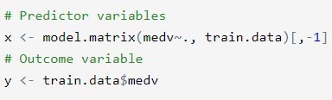
Penalized Models
Vijaya
Load Libraries and Load Data
Load the libraries and load Boston data available under MASS package. Additionally do some data preparation for computations

Slide 31

Compute Ridge Regression
Vijaya
Display Lambda value,coefficients & Prediction on test data
cv <- cv.glmnet(x, y, alpha = 0)
cv$lambda.min
model <- glmnet(x, y, alpha = 0, lambda = cv$lambda.min)
coef(model)
x.test <- model.matrix(medv ~., test.data)[,-1]
predictions <- model %>% predict(x.test) %>% as.vector()
data.frame( RMSE = RMSE(predictions, test.data$medv),
Rsquare = R2(predictions, test.data$medv))

Slide 32

Compute Lasso Regression
Vijaya
Display Lambda value,coefficients & Prediction on test data
cv <- cv.glmnet(x, y, alpha = 1)
cv$lambda.min
model <- glmnet(x, y, alpha = 1, lambda = cv$lambda.min)
coef(model)
x.test <- model.matrix(medv ~., test.data)[,-1]
predictions <- model %>% predict(x.test) %>% as.vector()
# Model performance metrics
data.frame( RMSE = RMSE(predictions, test.data$medv),
Rsquare = R2(predictions, test.data$medv))

Slide 33
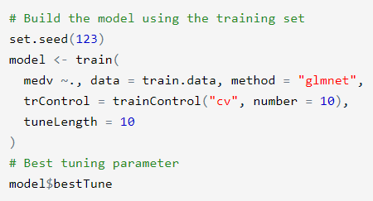
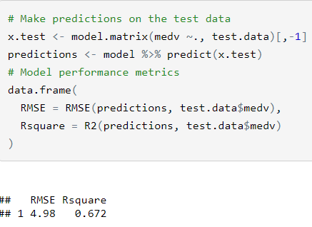

Compute Elastic Net Regression
Vijaya

Slide 34
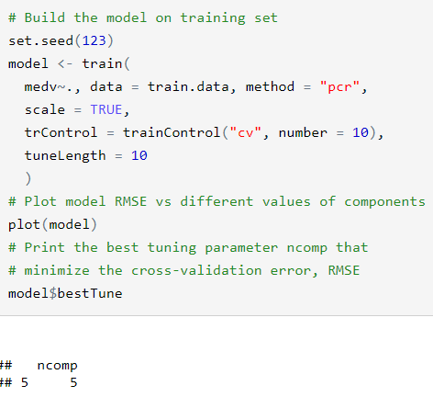
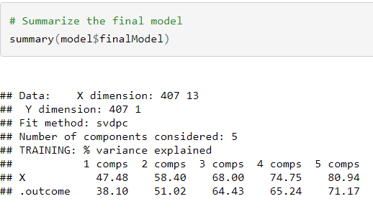
Principal Component Regression
Vijaya
Build the model and check for model predictions

Slide 35
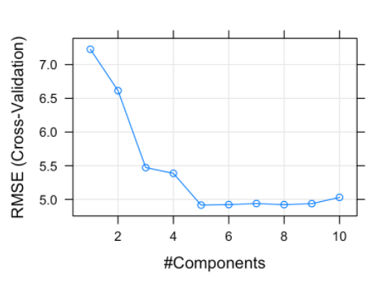
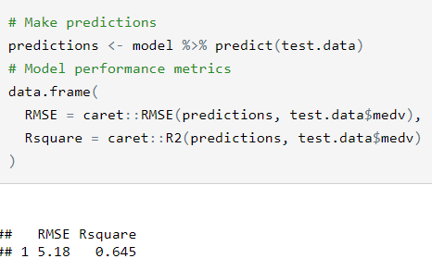
PCR Prediction
Vijaya
Our analysis shows that, choosing five principal components (ncomp = 5) gives the smallest prediction error RMSE.

Slide 36

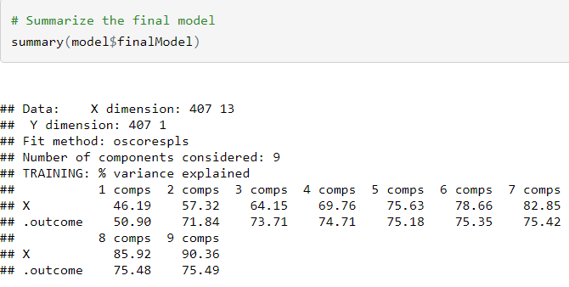
Partial Least Squares Regression
Vijaya
Build the model in same way as we did for PCR by changing method as “pls”

Slide 37
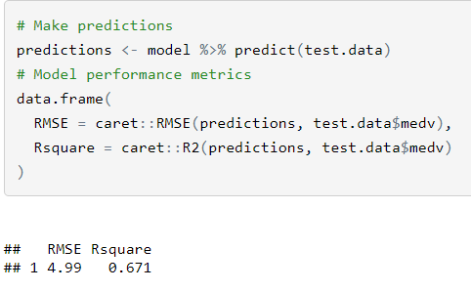
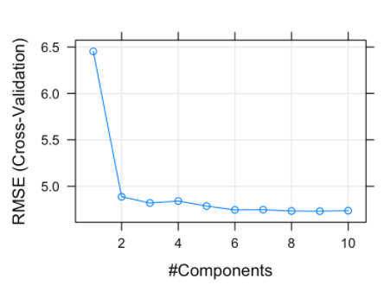
PLS Prediction
Vijaya
Cross-validation error RMSE obtained with the PLS model is lower than the RMSE obtained using the PCR method. So, the PLS model is the best model, for explaining our data, compared to the PCR model.

Slide 38
Conclusion
Vijaya
In our example dataset, while comparing Ridge, Lasso and Elastic net regression, we got lower RMSE for Elastic Net regression.
Similarly, when compared to PLS and PCR, we got less RMSE for PLS.
The takeaway is :
When compared to ridge regression and lasso, the final PCR and PLS models are more difficult to interpret, because they do not perform any kind of variable selection or even directly produce regression coefficient estimates.

Slide 39
References
Agresti, A. (2015). Foundations of Linear and Generalized Linear Models. Wiley, Hoboken, New Jersey. 1st edition.
Kuhn, M., & Johnson, K. (2013). Applied Predictive Modeling. New York: Springer.
Zhang, Y., & Collins-Thompson, K. (2002). Linear Methods for Regression. Advanced Statistical Learning Seminar.
Bruce, Peter, and Andrew Bruce. 2017. Practical Statistics for Data Scientists. O’Reilly Media.
James, Gareth, Daniela Witten, Trevor Hastie, and Robert Tibshirani. 2014. An Introduction to Statistical Learning: With Applications in R. Springer Publishing Company, Incorporated.

